Slide 1



Extending LLMs with RAG & MCP
Giving knowledge and hands to AI
Sangeeth Nandakumar | sangeeth.nandakumar@usthealthproof.com

Slide 2





What is an LLM?
Large Language Models
A Large Language Model (LLM) is an AI system that understands and generates human-like text based on the data it was trained on.

Slide 3


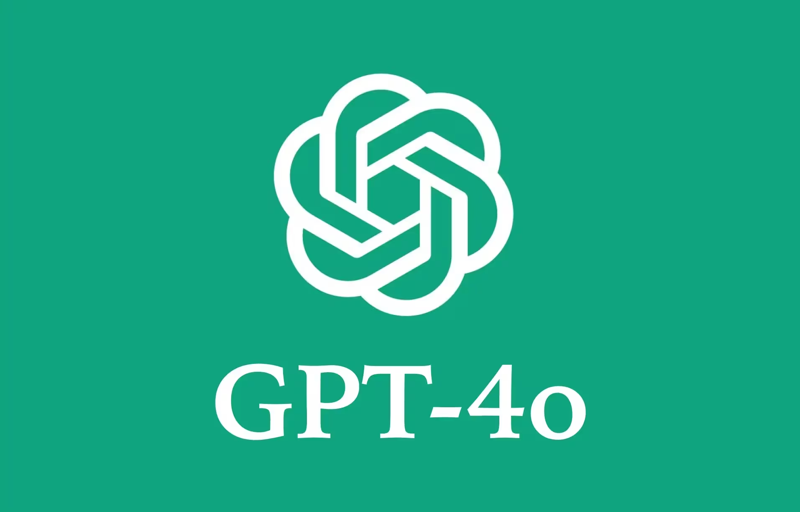
What is RAG?
Retrieval-Augmented Generation
A technique that optimizes the output of an LLM by referencing a local knowledge base outside its training data
Who is the PM of India?
Who all are in Reportal team?

Slide 4

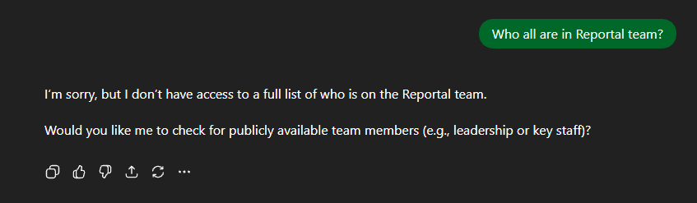
What is RAG?

Slide 5
With RAG
Retrieval-Augmented Generation
A technique that optimizes the output of an LLM by referencing a local knowledge base outside its training data
Who is the PM of India?
(Relevant Context) +
Who all are in reportal team?

Slide 6


Core Components of RAG
1. Ingestion
2. Embedding
3. Vector DB
4. Retrieval
PDFs, DBs or any datasource are sliced into chunks.
Chunks are converted into vectors (numbers) by an embedding model.
Vectors are stored in a database (e.g., Pinecone) for fast similarity search.
Relevant chunks are fetched and sent to the LLM.

Slide 7
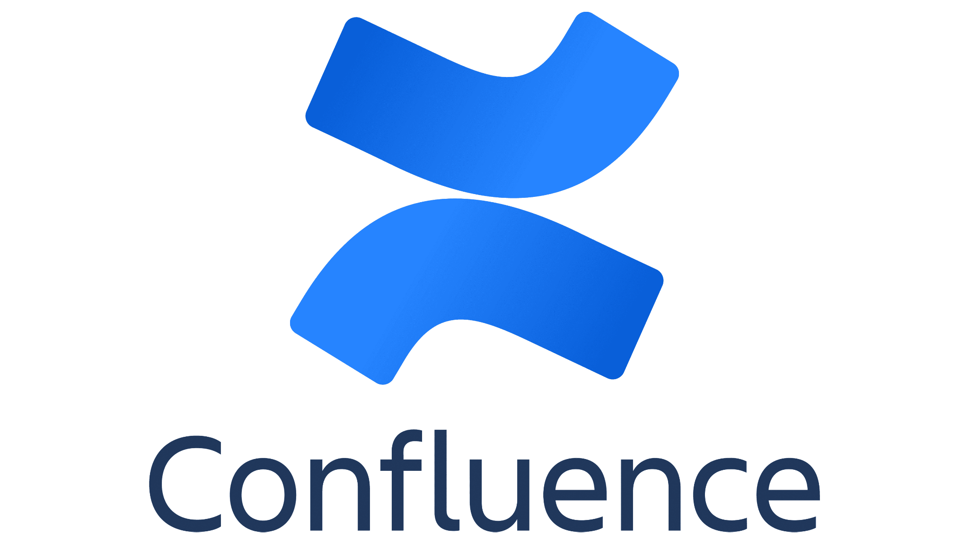

RAG Pipeline
Ingestion
Documents (PDFs, Wikis) are sliced into chunks.
Embedding
Chunks are converted into vectors (numbers) by an embedding model.
Vector Store
Vectors are stored in a database (e.g., Pinecone) for fast similarity search.
Retrieval
Relevant chunks are fetched and sent to the LLM.
(Relevant Context) + Who all are in Reportal team?

Slide 8
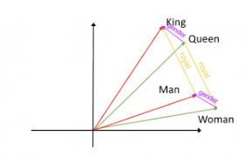
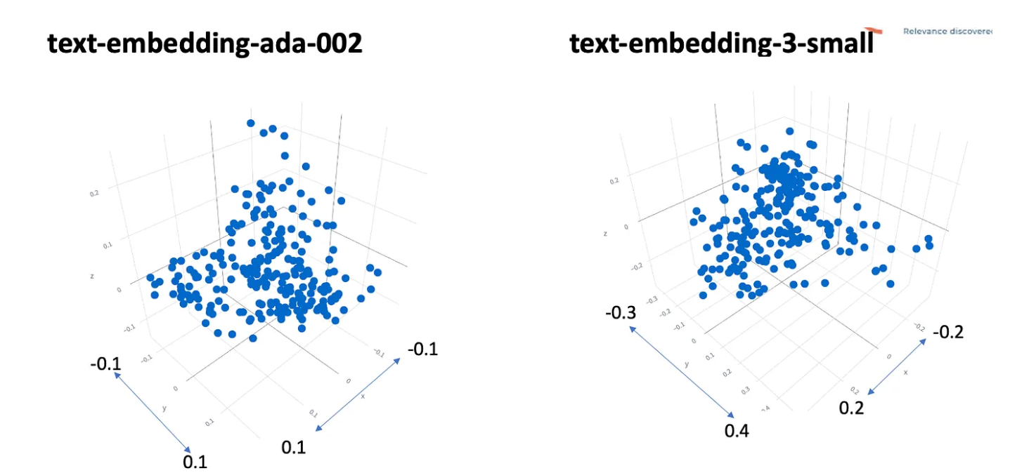
RAG Pipeline
Ingestion
Documents (PDFs, Wikis) are sliced into chunks.
Embedding
Chunks are converted into vectors (numbers) by an embedding model.
Vector Store
Vectors are stored in a database (e.g., Pinecone) for fast similarity search.
Retrieval
Relevant chunks are fetched and sent to the LLM.
Our Private Data
Our Private Embedding
Text Embedding Models

Slide 9
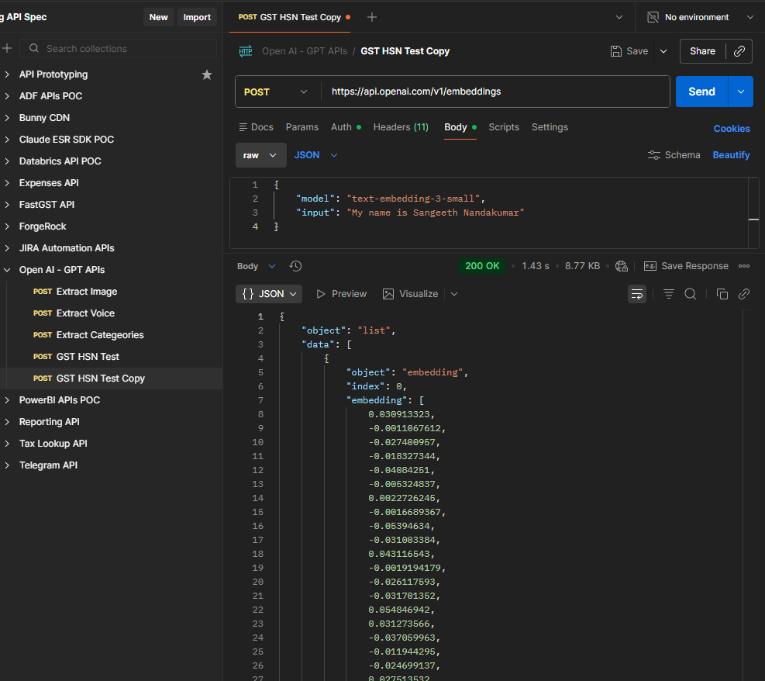
RAG Pipeline
Ingestion
Documents (PDFs, Wikis) are sliced into chunks.
Embedding
Chunks are converted into vectors (numbers) by an embedding model.
Vector Store
Vectors are stored in a database (e.g., Pinecone) for fast similarity search.
Retrieval
Relevant chunks are fetched and sent to the LLM.

Slide 10
RAG Pipeline
Ingestion
Documents (PDFs, Wikis) are sliced into chunks.
Embedding
Chunks are converted into vectors (numbers) by an embedding model.
Vector Store
Vectors are stored in a database (e.g., Pinecone) for fast similarity search.
Retrieval
Relevant chunks are fetched and sent to the LLM.
An ID
A vector embedding (array of numbers)
Optional metadata (like JSON tags, e.g.,
{"title": "Sangeeth, Name, Text, Male"})

Slide 11
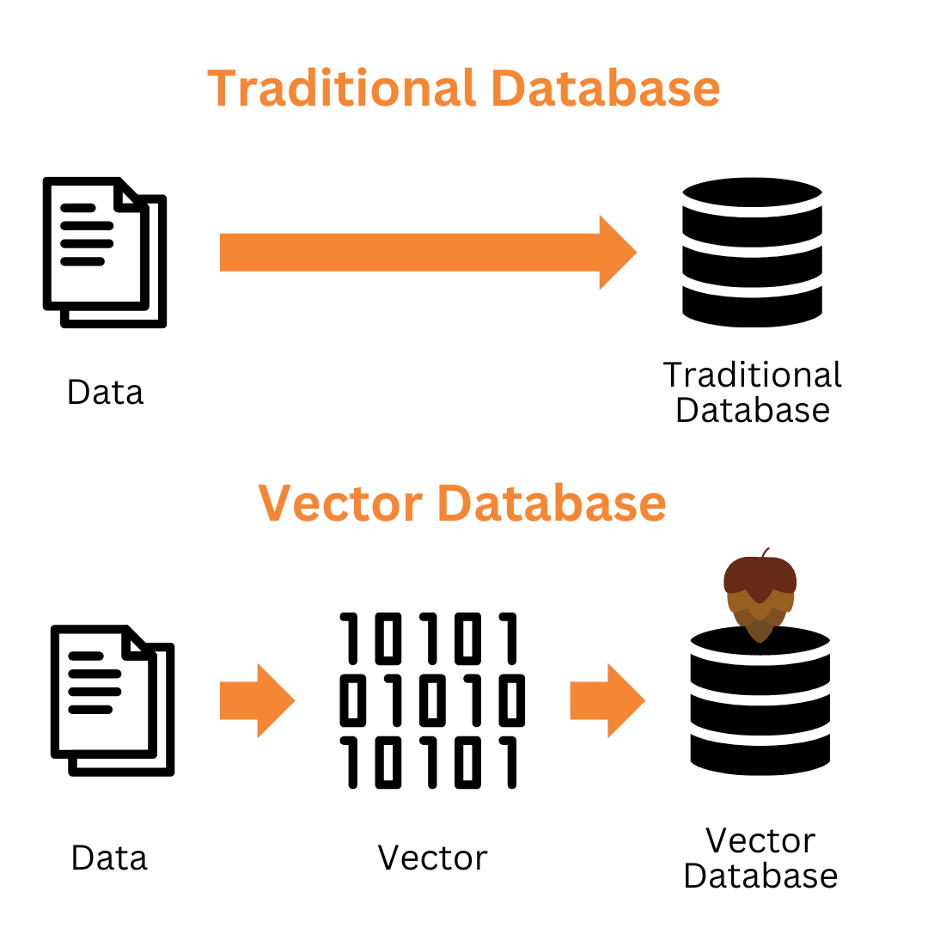
RAG Pipeline
Ingestion
Documents (PDFs, Wikis) are sliced into chunks.
Embedding
Chunks are converted into vectors (numbers) by an embedding model.
Vector Store
Vectors are stored in a database (e.g., Pinecone) for fast similarity search.
Retrieval
Relevant chunks are fetched and sent to the LLM.

Slide 12

RAG Pipeline
Ingestion
Documents (PDFs, Wikis) are sliced into chunks.
Embedding
Chunks are converted into vectors (numbers) by an embedding model.
Vector Store
Vectors are stored in a database (e.g., Pinecone) for fast similarity search.
Retrieval
Relevant chunks are fetched and sent to the LLM.
Our Private Embedding
Our Private DB

Slide 13
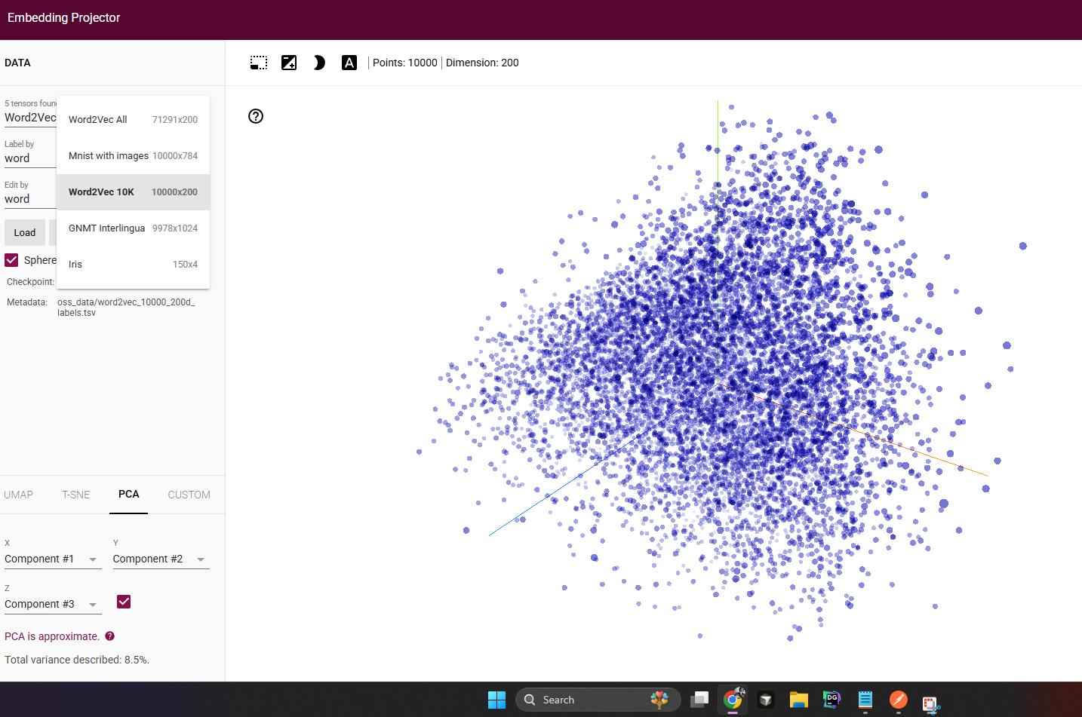
RAG Pipeline
Ingestion
Documents (PDFs, Wikis) are sliced into chunks.
Embedding
Chunks are converted into vectors (numbers) by an embedding model.
Vector Store
Vectors are stored in a database (e.g., Pinecone) for fast similarity search.
Retrieval
Relevant chunks are fetched and sent to the LLM.

Slide 14
RAG Pipeline
Ingestion
Documents (PDFs, Wikis) are sliced into chunks.
Embedding
Chunks are converted into vectors (numbers) by an embedding model.
Vector Store
Vectors are stored in a database (e.g., Pinecone) for fast similarity search.
Retrieval
Relevant chunks are fetched and sent to the LLM.
query = "What is my name?"
query_embedding = client.embeddings.create(
model="text-embedding-3-small",
input=query
)['data'][0]['embedding']
# Find top matching vectors
results = index.query(
vector=query_embedding,
top_k=1,
include_metadata=True
)

Slide 15
Retrieval With RAG
Retrieval-Augmented Generation
A technique that optimizes the output of an LLM by referencing a local knowledge base outside its training data
Who is the PM of India?
(Nearest Embeddings From PineCone) +
Who all are in reportal team?

Slide 16


Advantages Of RAG
Retrieval-Augmented Generation
A technique that optimizes the output of an LLM by referencing a local knowledge base outside its training data
Reduces Hallucinations
Real-Time Knowledge
Data Privacy
The model became aware of local context
LLMs have a training cutoff. RAG allows access to private data without retraining.
Our sensitive enterprise data within us, exposing it only when needed.

Slide 17



Challenges in RAG
Retrieval Quality
Latency
Semantic search isn't perfect.
If vector matching quality is not great, LLMs response might not be very good
Adding a database search step adds time. Optimizing vector search speed is critical for real-time apps.
Context Windows
LLMs have a limit on how much text they can read
We can't just feed them the whole database, we must be selective

Slide 18
Extending LLMs with RAG & MCP
Giving knowledge and hands to AI
Sangeeth Nandakumar | sangeeth.nandakumar@usthealthproof.com

Slide 19
Enter MCP The Model Context Protocol
Standardizing how AI connects to the world.

Slide 20
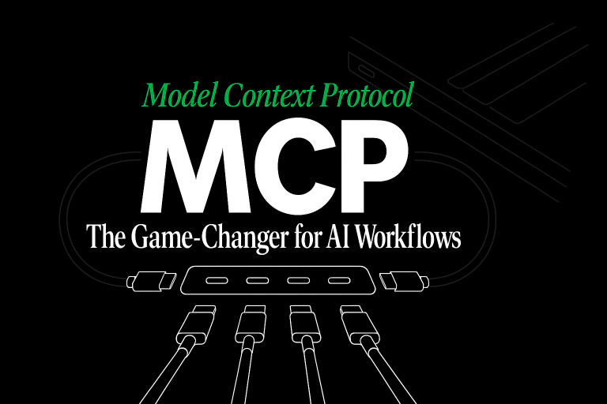

Slide 21

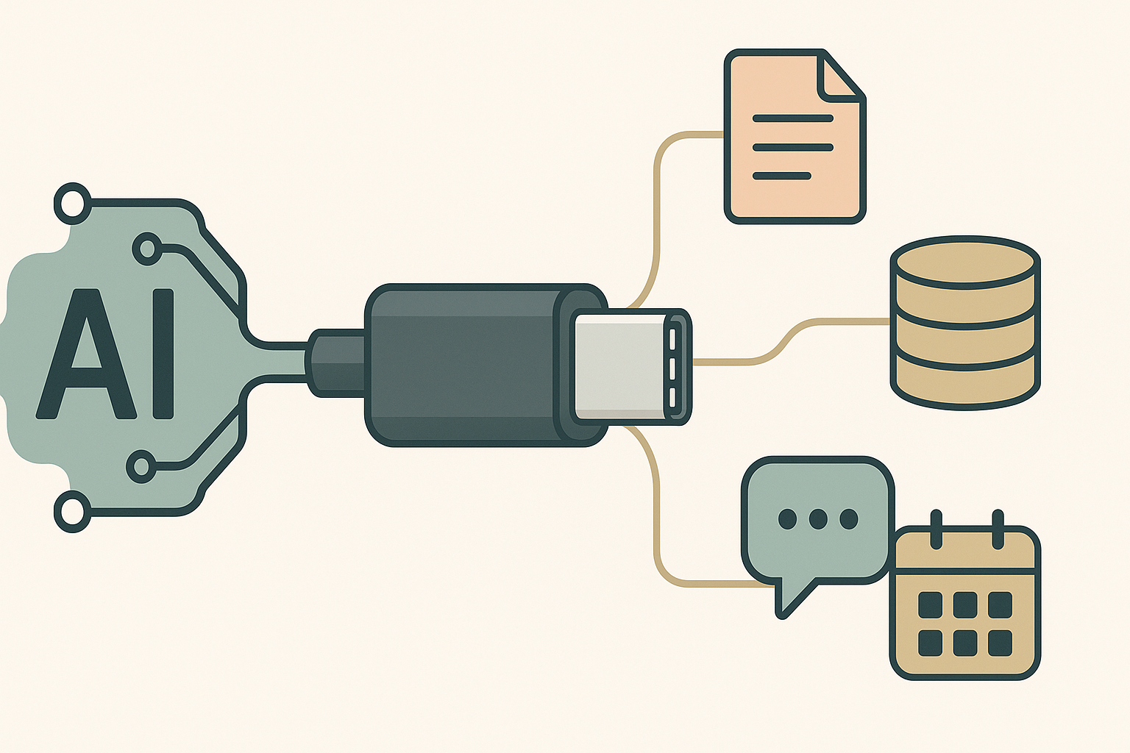
What is MCP?
The "USB-C" for AI
The Model Context Protocol (MCP) is an open standard that enables AI models to safely access data and tools.
Before MCP, every integration (Google Drive, Postgres) required custom code. MCP provides a universal interface.

Slide 22

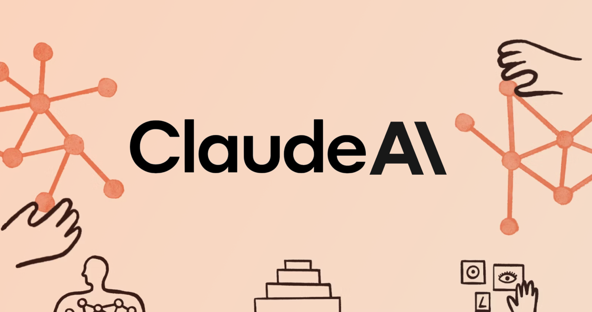
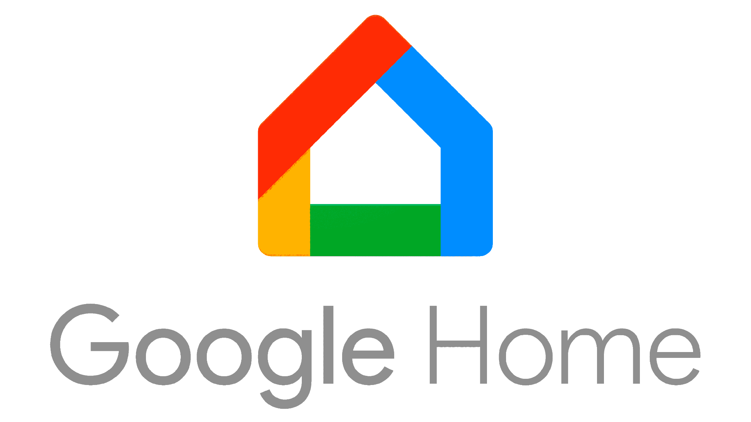
Agentic Actions With MCP
Model Context Protocol
MCP is a standard protocol for connecting LLMs with external tools so it can perform
context aware real world actions or work in Agentic mode
Relayed
Turn on the lights
CMD: {TurnOnLights()}
Sure, Done
CMDR: {true}

Slide 23
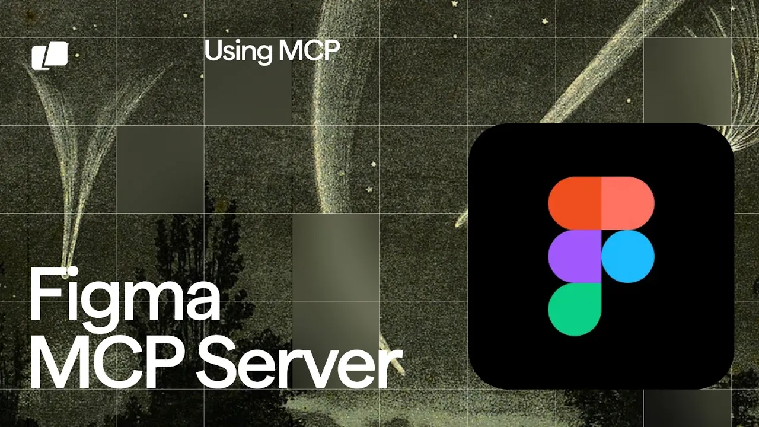
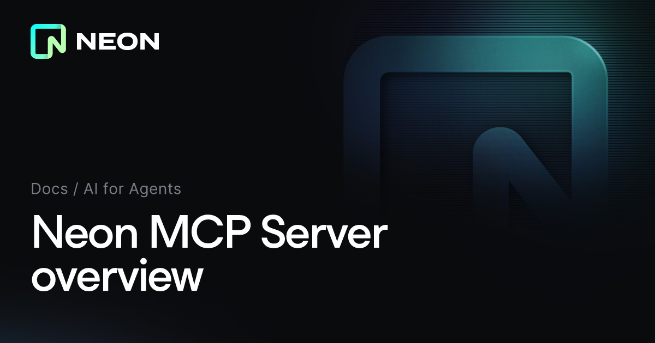
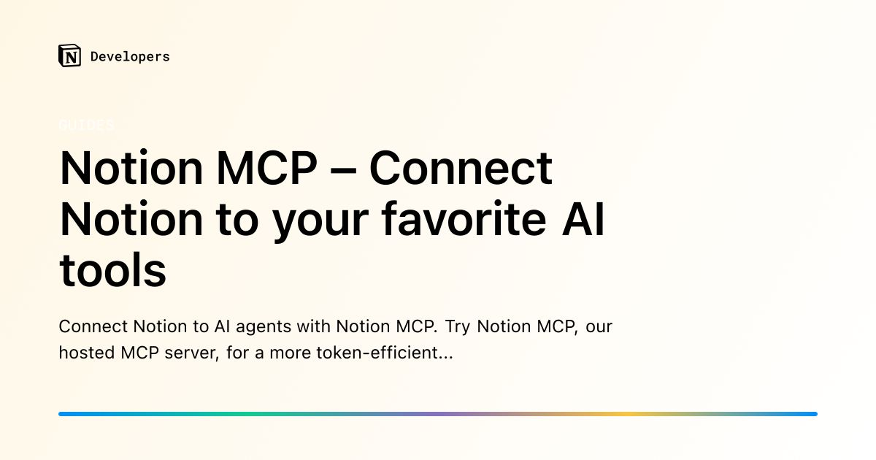
Top Companies Exploring MCP

Slide 24
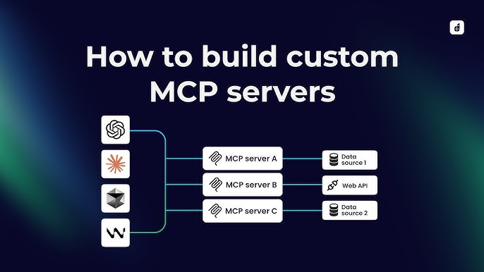
Our Own Custom MCP Servers

Slide 25
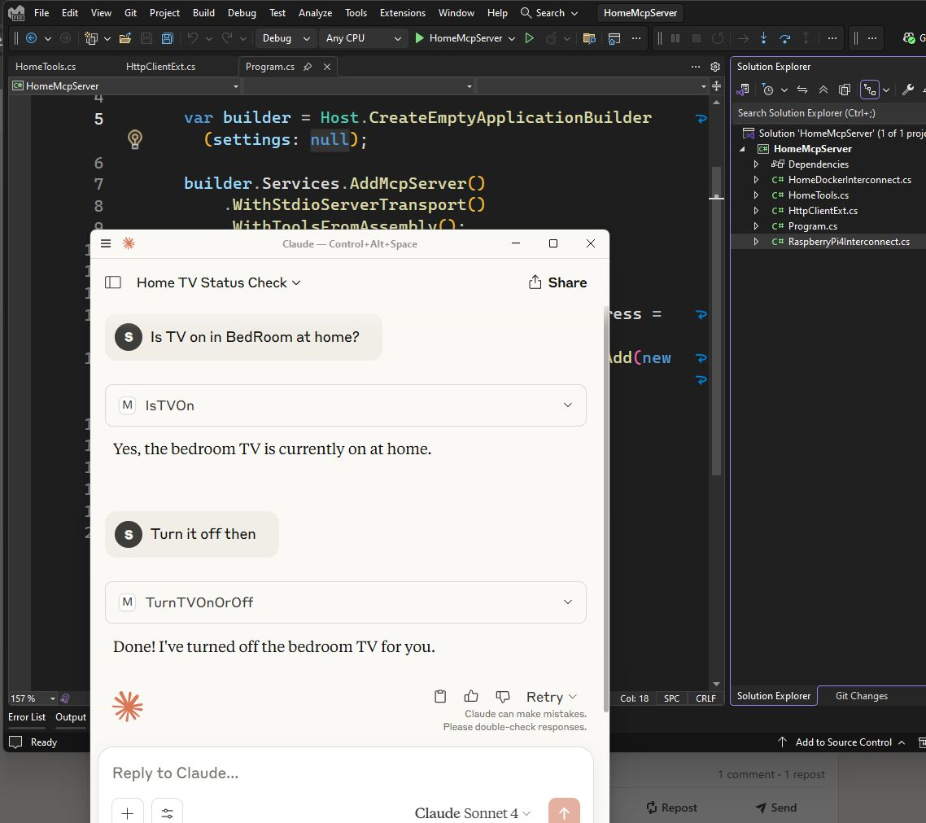
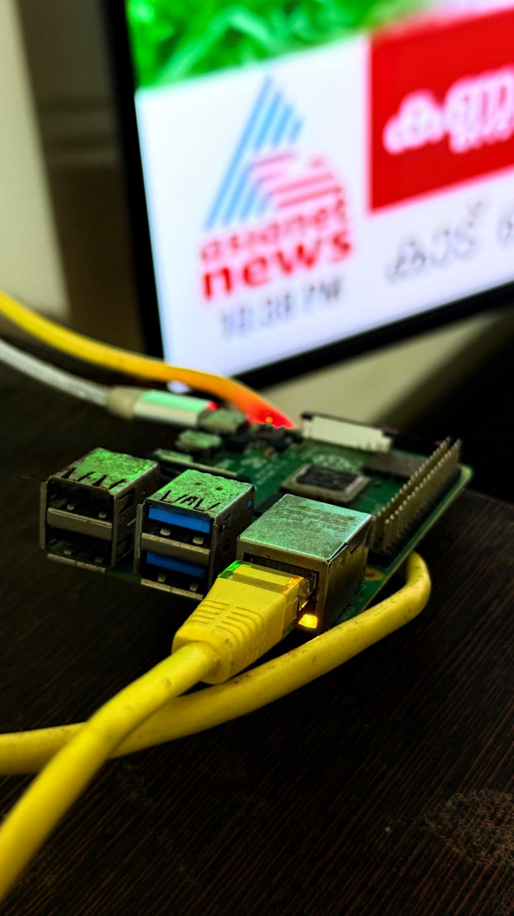

Slide 26

MCP Architecture
MCP Host: The AI application (e.g. Claude) that wants to use tools.
MCP Client: A 1:1 connector inside the host.
MCP Server: A lightweight program that exposes the data or tools.
Transport: Connects via local StdIO or remote HTTP/SSE.

Slide 27









Core Capabilities of MCP
Resources
Prompts
Tools
File-like data that can be read by the client (e.g., logs, code files, database records).
Pre-written templates that help users use the server's capabilities effectively.
Executable functions that perform actions (e.g., "create_file", "query_database").

Slide 28






Why Adopt MCP?
Universal
Secure
Extensible
Build a tool once (e.g., "Postgres MCP Server") and it works with Claude, Zed, and any other MCP host.
The host controls the connection. Models can't access data unless the user explicitly enables the MCP server.
Developers can easily create "connectors" for their internal APIs without waiting for model providers to build them.

Slide 29

MCP Use Cases
Coding Agents: IDEs using MCP to read local files, run terminal commands, and check git status.
Enterprise Data: Connecting a general LLM to internal SQL databases or Slack history securely.
Workflow Automation: An agent that can check a calendar, draft an email, and send it via an API tool.

Slide 30
RAG vs. MCP
Feature | RAG | MCP
Primary Goal | Retrieve Knowledge | Execute Actions & Connect Tools
Mechanism | Vector Search & Similarity | Standardized API Contract
Best For | Answering questions based on docs | Interacting with systems (DBs, APIs)
Analogy | The Library | The Hands / Tools

Slide 31


The Power Combo: RAG + MCP
Context-Aware Agents
Combining RAG and MCP creates systems that can both know and do.
Example: An MCP server that exposes a "Search Knowledge Base" tool. The Agent uses MCP to call the RAG pipeline, gets the info, and then uses another MCP tool to email the summary.

Slide 32
The Future is Connected
By combining the retrieval power of RAG with the interoperability of MCP, we are moving from static chatbots to capable, reliable, and integrated AI Agents.

Slide 33
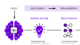

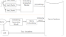

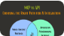
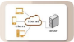
Image Sources
https://www.weka.io/wp-content/uploads/files/2023/06/ai-technology-diagram.png
Source: www.weka.io
https://timescale.ghost.io/blog/content/images/2024/04/A-Beginner-s-Guide-to-Vector-Embeddings.png
Source: www.tigerdata.com
https://miro.medium.com/1*3--ogs382Na1U2v3LfVVcQ.png
Source: medium.com
https://img.freepik.com/premium-photo/laptop-displaying-chatbot-interface-with-neon-outlines-dark-background-concept-ai-communication-3d-rendering_670147-108309.jpg
Source: www.freepik.com
https://anarsolutions.com/wp-content/uploads/2025/07/MCP-vs.-API-Choosing-the-Right-Path-for-AI-Integration-500x500.png
Source: anarsolutions.com
https://media.geeksforgeeks.org/wp-content/uploads/20240715173920/Client-Server-Architecture.webp
Source: www.geeksforgeeks.org

Slide 34


Image Sources
https://smythos.com/wp-content/uploads/2025/02/futuristic_command_center-842x474.jpeg
Source: smythos.com
https://cdn.prod.website-files.com/65832da1bd141cc4c50ca25c/675b20f9491c4eed0f3a566f_puzzle_pieces.webp
Source: www.renflowdesigns.com

